Slide 1
THE 1 PAGE BUILD-A-BOT RESOURCE
By: Matt Spurk, CERobots.com
Transmitter
The part you hold that sends the command signals to your bot. When you move a lever (commonly referred to as the stick) the bot responds to that input. Most new transmitters have different programmable options that can seem overwhelming at first, but will really help control the bot.
Common Sources –
www.fingertechrobotics.com
www.robotmarketplace.com
www.hobbyking.com
Local hobby shops and www.amazon.com also carry transmitters. Buyer beware that not all transmitters failsafe (stop the bot) when the signal is lost. It’s really not good if your bot decides to drive off into the sunset or the weapon continues to spin for hours after you command it to stop.
Gear-motors
Gear-motors are the legs of the bot. They are the muscle. They are the engine and transmission of your car. Electric motors spin at several thousand RPMs. Sometimes over 10,000 RPM. This is clearly much too fast to mount a tire to directly. Like your car transmission, a series of gears slows the motor output to a more reasonable RPM.
Common Sources –
www.fingertechrobotics.com
www.robotmarketplace.com
www.kitbots.com
www.botkits.com
Occasionally, you can find the right kind of gear-motors on eBay, but it’s a crap-shoot. The motors provided at the sites above are all battle-tested and/or battle-hardened.
Receiver
The receiver is the brains of the bot. It convert s the over-the-air frequencies to the signals that control the drive or weapon speed controller.
Common Sources – Most transmitters come with receivers, but a few do not.
www.fingertechrobotics.com
www.robotmarketplace.com
www.hobbyking.com
Local hobby shops and www.amazon.com also carry receivers, but not all receivers work with all transmitters. Verify correct receiver for the job before ordering.
Batteries
The batteries are the heart of the bot. The supply the energy to the speed controllers to drive the motors. Also, most combat ESCs have a Battery Eliminator Circuit (BEC) that can power the receiver as well.
www.fingertechrobotics.com
www.robotmarketplace.com
www.hobbyking.com
Local hobby shops and www.amazon.com also carry batteries.
Resources
http://sparc.tools/ – Basically everything (Rules, Procedures, Getting started guide, forum, etc.)
http://riobotz.com/pb/tutorial/ – As the address implies, it’s a tutorial about how to build a robot. Highly recommended
http://cerobots.com/ - Blog posts of new bots. Tips to help you get started. Overall just the coolest site on the net (and run by yours truly).
Electronic Speed Controllers (ESC)
The ESC is like the spinal cord of your bot. It takes the signals from the receiver and controls the speed and direction of the motors. There are single channel ESCs (work with 1 motor) and dual ESCs (designed to control 2 motors (one for each side)).
Common Sources –
www.fingertechrobotics.com
www.robotmarketplace.com
www.botbitz.com
www.robotpower.com
Local hobby shops and www.amazon.com carry ESCs, but most are not well suited to combat bots. Combat ESCs are designed to be reversible and most hobby ESCs must stop the motor completely before changing direction if they can at all.

Slide 2
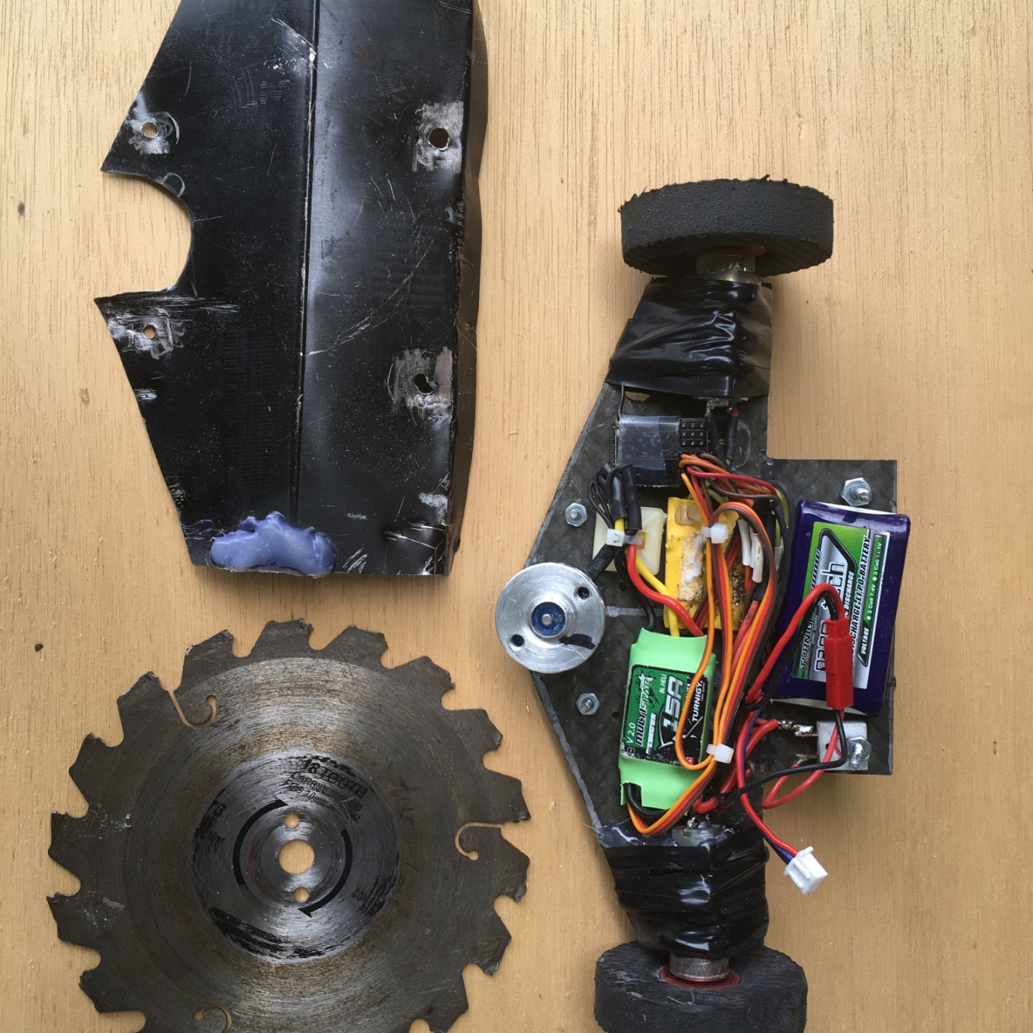
BRUSHLESS SPEED CONTROLLER
www.hobbyking.com
BRUSHLESS MOTOR
W/ HUB
www.hobbyking.com
www.fingertech.com
TIRE
Flip flops cut into circles
HUB
www.fingertech.com
GEARMOTOR
www.fingertech.com
RECEIVER
www.lemonrx.com
SWITCH
www.fingertech.com
BATTERY
www.hobbyking.com
SPEED CONTROLLER
www.fingertech.com

